Slide 2
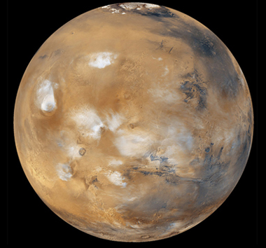
NEXT
Photo courtesy of USDAgov (@flickr.com) - granted under creative commons licence - attribution

Slide 3
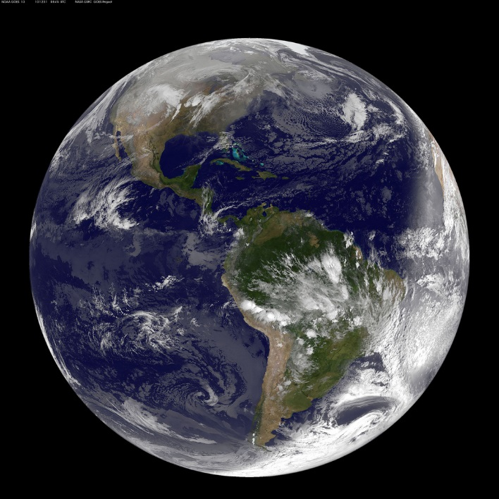
NEXT
Photo courtesy of NASA Goddard Photo and Video (@flickr.com) - granted under creative commons licence - attribution

Slide 4
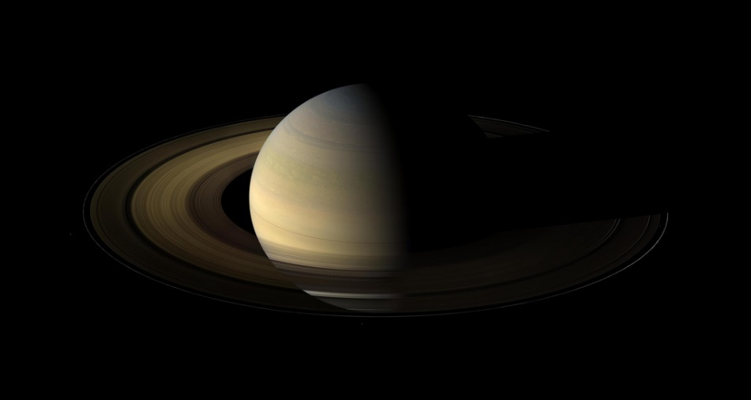
NEXT
Photo courtesy of NASA Goddard Photo and Video (@flickr.com) - granted under creative commons licence - attribution

Slide 5
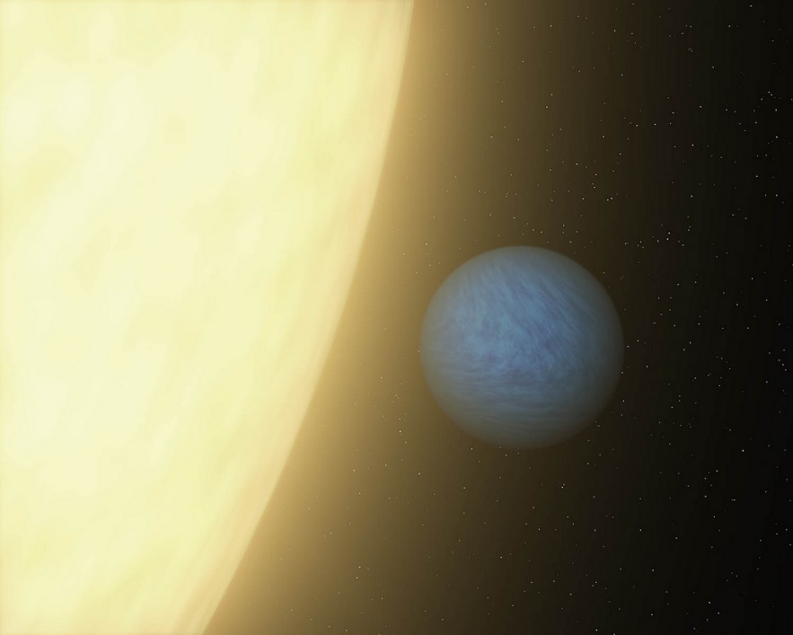
NEXT
Photo courtesy of NASAblueshift (@flickr.com) - granted under creative commons licence - attribution

Slide 6
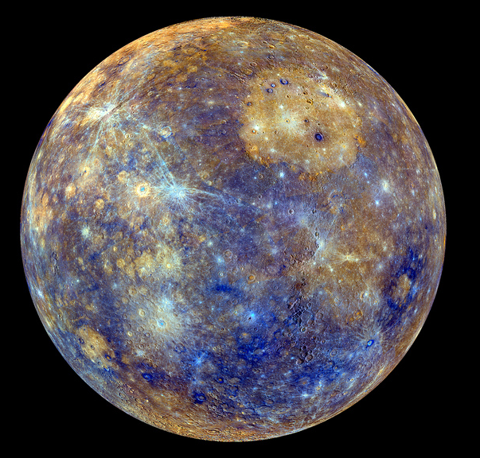
NEXT
Photo courtesy of NASA Goddard Photo and Video (@flickr.com) - granted under creative commons licence - attribution

Slide 7
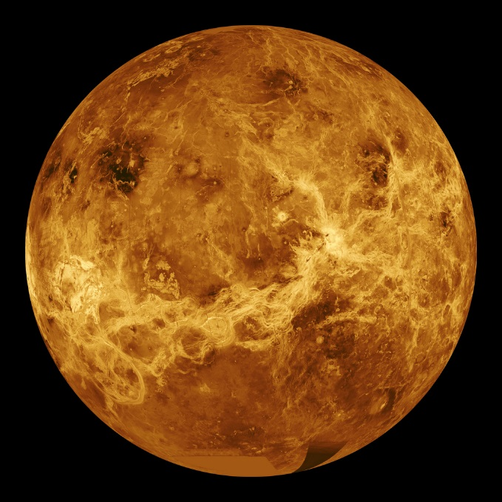
NEXT
Photo courtesy of NASA Goddard Photo and Video (@flickr.com) - granted under creative commons licence - attribution

Slide 8
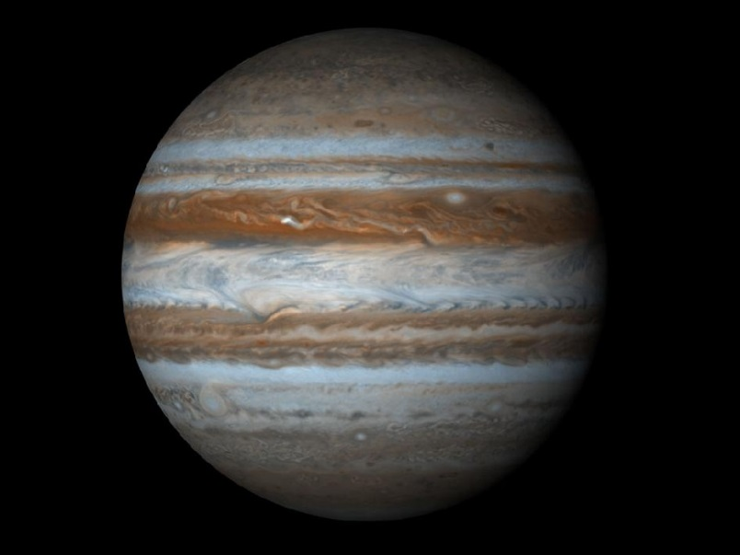
NEXT
Photo courtesy of NASA Goddard Space Flight Center (@flickr.com) - granted under creative commons licence - attribution

Slide 9
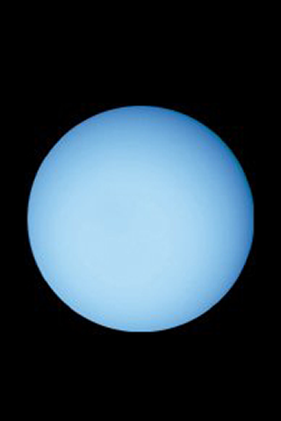
NEXT
Photo courtesy of chrismeller (@flickr.com) - granted under creative commons licence - attribution

Slide 10
THE END

