Slide 1
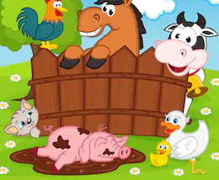
Farm Animals.

Slide 2
Los animales de la granja /Farm animals

Slide 3
Recap:

Slide 4
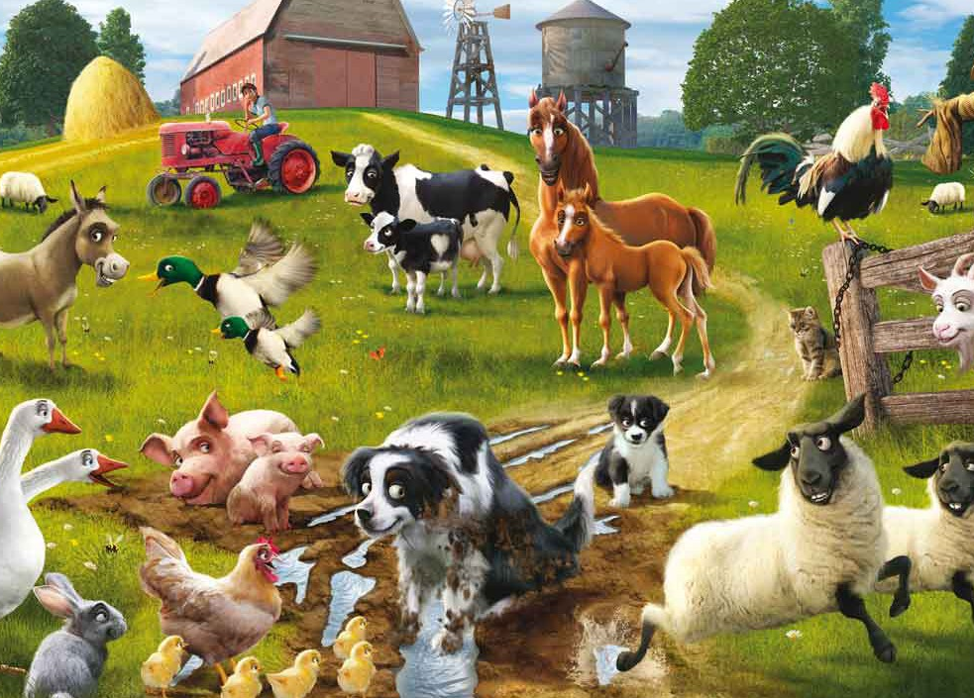
ACTIVITY:
Describe the picture.
Make a list of the different farm animals.
Say how many animals there are and what color they are.
For example:
(Hay = There are)
'Hay dos cerdos rosas'
'There are two pink pigs'
-Your turn:
Hay _____ ______ ______
Hay _____ _______ ______

