Slide 1
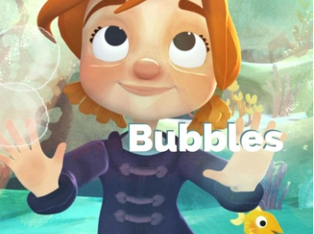

Slide 2
Watch the short video Bubbles:
https://www.literacyshed.com/bubbles.html
(If this link doesn’t work please google The Literacy Shed and you can find the ‘Bubbles’ video in the Fantasy Shed section.)

Slide 4
Monday - Comprehension
Bubbles Comprehension Questions
Answer these questions in your Home Learning Book
How is the little girl feeling at the beginning before she finds the bubbles? How do you know?
How does the weather change when she blows the bubbles? Why do you think this is?
Do you like blowing bubbles? Why?
How did she feel when she first flew up on a bubble? Would you feel the same? Why?
How did she use the bubbles to move around? Think about the different ways she does this.
Where does she go on the bubbles?
Which bit do you think is the most exciting part?

Slide 5
Monday - Comprehension

Slide 6
Tuesday – Draw a Story Map
S
Use the pictures on the Knowledge Organiser to help you.

Slide 7
Wednesday – Where would you go?
Think about the girl’s adventure. Was it a fun adventure? Where would you like to go on a bubble? Why? Can you explain using different conjunctions? Underline each one that you use. You can start like this if you like: I would like to go to ________________ because… Use the Bubbles Knowledge Organiser to help you. Conjunctions and but because when so if then after later although

Slide 8
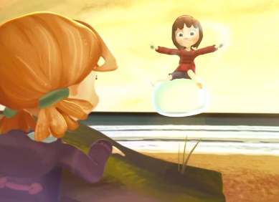
Thursday – Where would you go?
Think about the end of the video. The new little girl picks up the bubbles and starts her own adventure. Where does she go? Write the next chapter. Draw pictures too. Remember to use lots of words to explain how she is feeling. Use the words on the Bubbles Knowledge Organiser to help you.
Feelings
happy delighted upset unhappy miserable confused
anxious worried terrified lonely curious bewildered
frightened elated excited
Vocabulary
beach bubble magical adventure girl amazed sky sea flew mysterious
fish stars planets

Slide 9
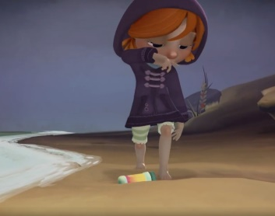
Friday – Change the story…
Your last challenge of the week is to think about how you can change the story. What object could you find on the beach? (for example a shell)
What might happen when you pick it up? Write this story in your Home Learning Book. Remember the story needs to have a beginning, a middle and an end. How many words can you use from the Bubble Knowledge Organiser? Can you add in your own exciting vocabulary?

