Slide 1
LIFE/work balance
We have started a #LIFEworkbalance campaign and we need your help to complete our LIFE/work balance survey.
We hope to publish the results soon, so please give 15 minutes of your time to help us get a true picture of school life.
Want to be a part of this campaign? Take the survey on our website and share it with your colleagues!
© Classroom Secrets Limited 2019

Slide 2
Year 6 – Spring Block 6 – Ratio – Calculating Ratio
About This Resource:
This PowerPoint has been designed to support your teaching of this small step. It includes a starter activity and an example of each question from the Varied Fluency and Reasoning and Problem Solving resources also provided in this pack. You can choose to work through all examples provided or a selection of them depending on the needs of your class.
National Curriculum Objectives:
Mathematics Year 6: (6R1) Solve problems involving the relative sizes of two quantities where missing values can be found by using integer multiplication and division facts
Mathematics Year 6: (6R3) Solve problems involving similar shapes where the scale factor is known or can be found
Mathematics Year 6: (6R4) Solve problems involving unequal sharing and grouping using knowledge of fractions and multiples
More Year 6 Ratio resources.
Did you like this resource? Don’t forget to review it on our website.
© Classroom Secrets Limited 2019

Slide 3
Year 6 – Spring Block 6 – Ratio
Step 4: Calculating Ratio
© Classroom Secrets Limited 2019

Slide 4
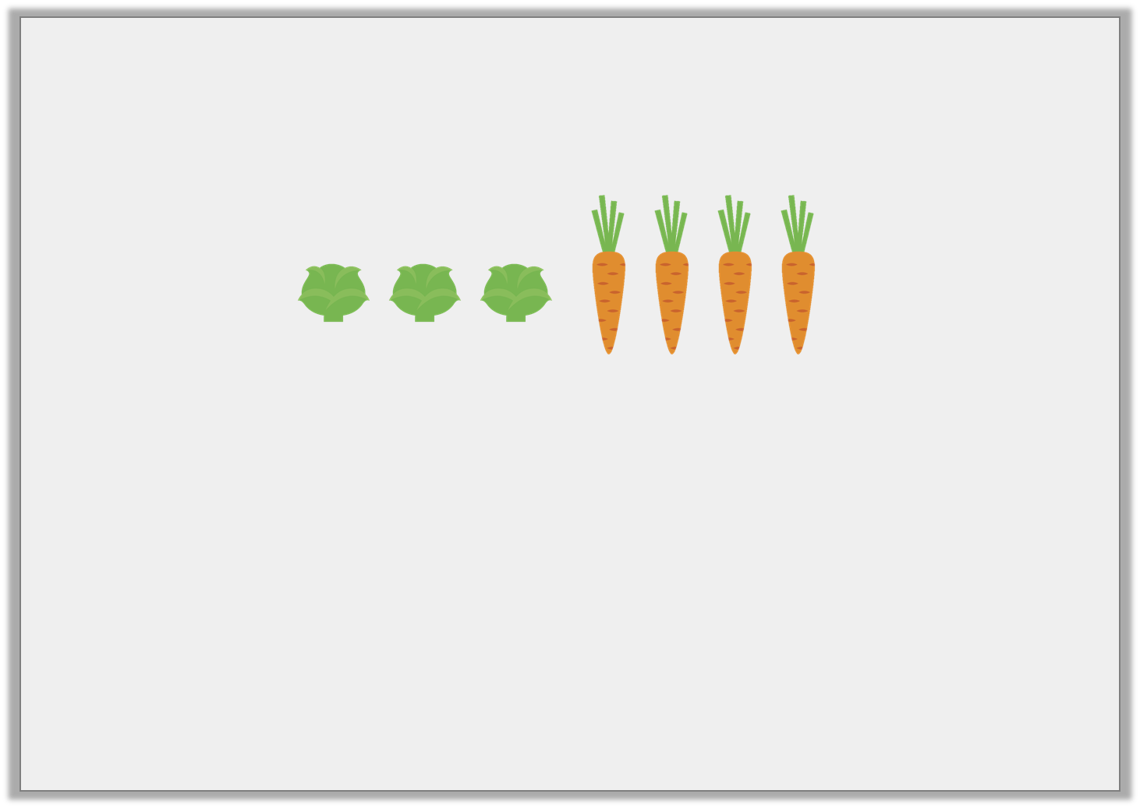
Introduction
Complete the sentences using the images below.
For every |  | sprouts there are |  | carrots.
 | of the vegetables are sprouts, |  | of the vegetables are carrots.
 | :
© Classroom Secrets Limited 2019

Slide 5
Introduction
Complete the sentences using the images below.
For every | 3 | sprouts there are | 4 | carrots.
3 | of the vegetables are sprouts, | 4 | of the vegetables are carrots.
 |  | 7
7
3 | : | 4
© Classroom Secrets Limited 2019

Slide 6
Varied Fluency 1
Use the image below to complete the ratio statements.
For every _____ teacher, there are _____ pupils.
If there are 12 teachers, how many pupils will there be?
© Classroom Secrets Limited 2019

Slide 7
Varied Fluency 1
Use the image below to complete the ratio statements.
For every _____ teacher, there are _____ pupils.
If there are 12 teachers, how many pupils will there be?
120
1
10
© Classroom Secrets Limited 2019

Slide 8
Varied Fluency 2
There are 35 animals on a farm. For every 5 cows there are 2 pigs. Use the bar model to help you calculate:
How many cows altogether?
How many pigs altogether?
© Classroom Secrets Limited 2019

Slide 9
Varied Fluency 2
There are 35 animals on a farm. For every 5 cows there are 2 pigs. Use the bar model to help you calculate:
How many cows altogether?
How many pigs altogether?
25
10
© Classroom Secrets Limited 2019

Slide 10
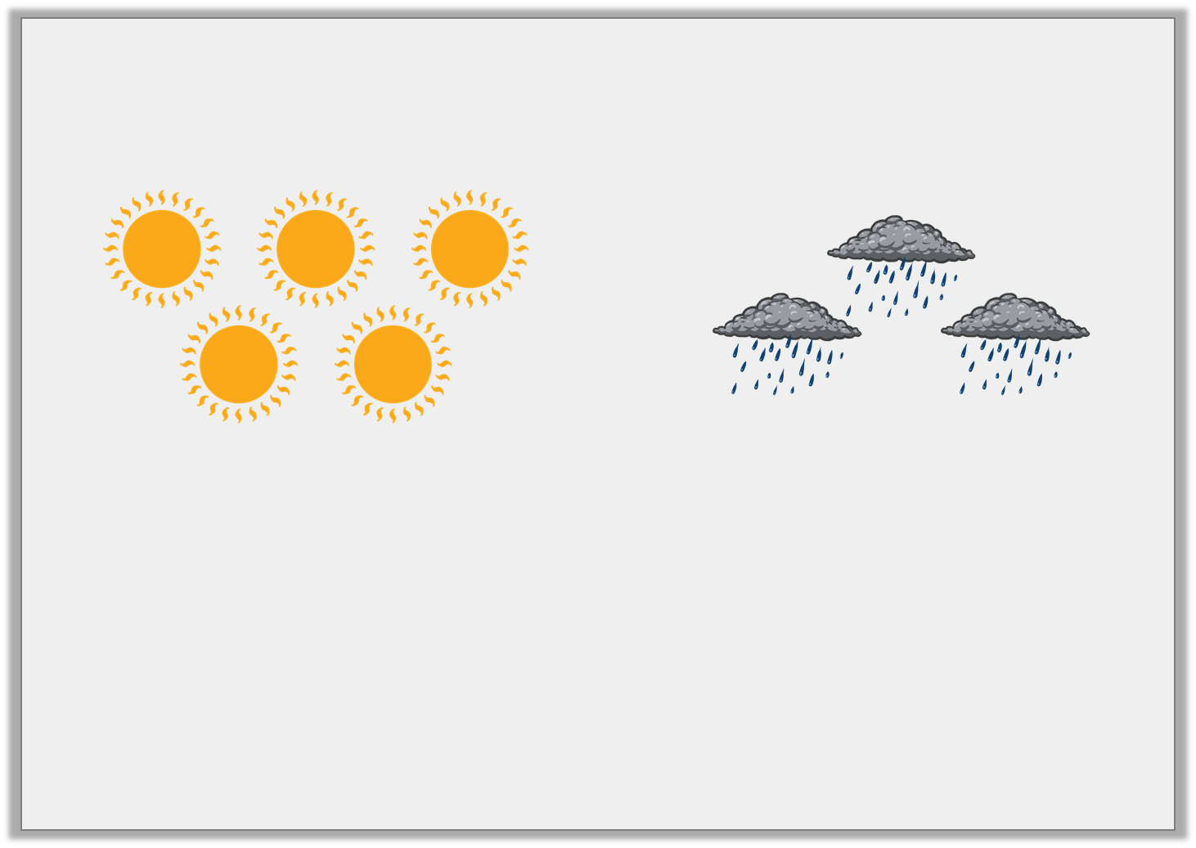
Varied Fluency 3
What is the ratio of suns to rainclouds?
Use the ratio to calculate how many symbols there
will be altogether if there are 20 suns.
suns
rainclouds
symbols altogether
:
20
© Classroom Secrets Limited 2019

Slide 11
Varied Fluency 3
What is the ratio of suns to rainclouds?
Use the ratio to calculate how many symbols there
will be altogether if there are 20 suns.
suns
rainclouds
symbols altogether
5
:
3
20
12
32
© Classroom Secrets Limited 2019

Slide 12
Problem Solving 1
Mary is making buns for her birthday party but has limited ingredients.
For every 3 chocolate buns, she makes 2 vanilla buns.
There are 66 people at the party and of the people want
a vanilla bun.
How many chocolate buns will Mary make?
How many people will not receive a bun?
1
3
© Classroom Secrets Limited 2019

Slide 13
Problem Solving 1
Mary is making buns for her birthday party but has limited ingredients.
For every 3 chocolate buns, she makes 2 vanilla buns.
There are 66 people at the party and of the people want
a vanilla bun.
How many chocolate buns will Mary make?
33
How many people will not receive a bun?
11
1
3
© Classroom Secrets Limited 2019

Slide 14
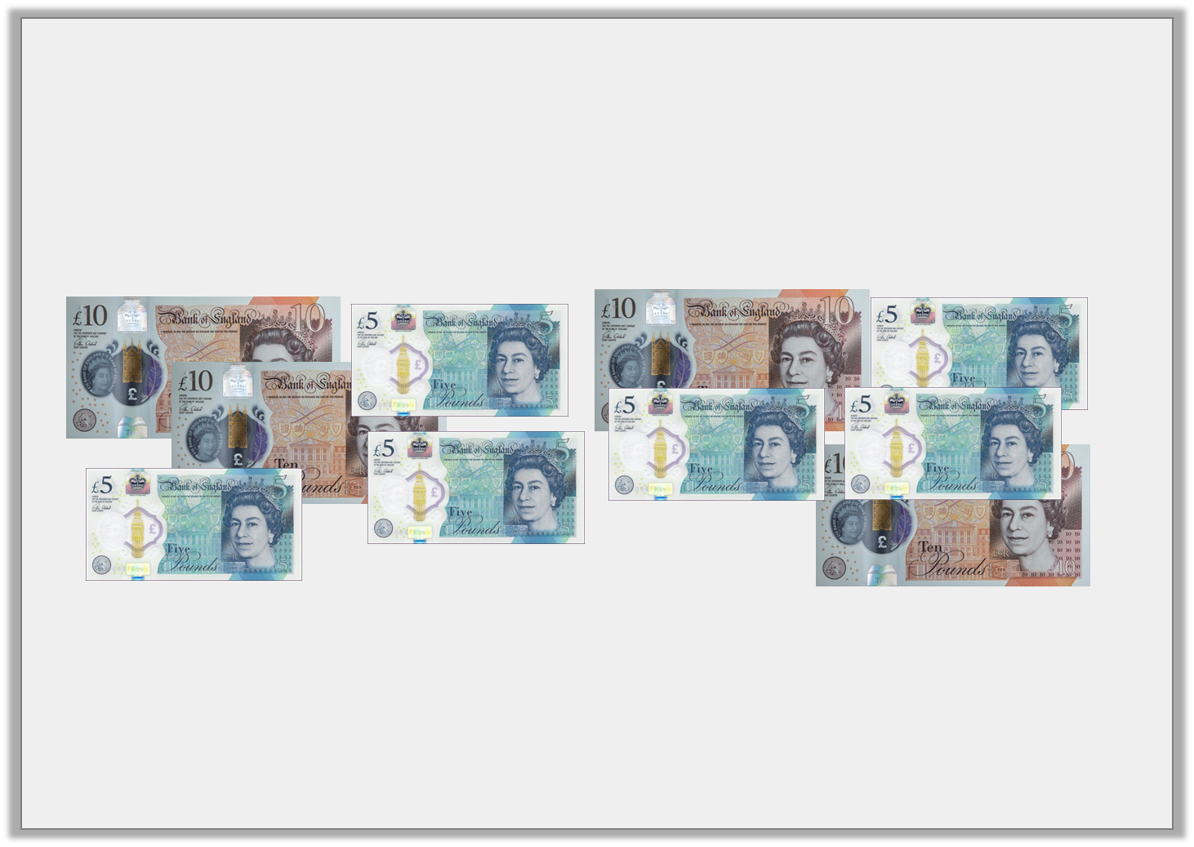
Reasoning 1
A cashier is sorting the money in the till.
He works out the ratio of £5 notes to £10 notes is 2:1
Have the notes been sorted correctly?
Explain your answer.
© Classroom Secrets Limited 2019

Slide 15
Reasoning 1
A cashier is sorting the money in the till.
He works out the ratio of £5 notes to £10 notes is 2:1
Have the notes been sorted correctly?
Explain your answer.
No because…
© Classroom Secrets Limited 2019

Slide 16
Reasoning 1
A cashier is sorting the money in the till.
He works out the ratio of £5 notes to £10 notes is 2:1
Have the notes been sorted correctly?
Explain your answer.
No because there are 1 too many £10 notes (or there needs to be 2 more £5 notes).
© Classroom Secrets Limited 2019

Slide 17
Problem Solving 2
For every blue front door on the row of terraces, there are 2 red doors. There are 12 blue doors altogether.
One third of the red doors are repainted blue.
What is the new ratio of blue doors to red doors?
How many red doors are there altogether?
© Classroom Secrets Limited 2019

Slide 18
Problem Solving 2
For every blue front door on the row of terraces, there are 2 red doors. There are 12 blue doors altogether.
One third of the red doors are repainted blue.
What is the new ratio of blue doors to red doors?
20:16 (accept 5:4)
How many red doors are there altogether?
16
© Classroom Secrets Limited 2019

