Slide 1
LIFE/work balance
We have started a #LIFEworkbalance campaign and we need your help to complete our LIFE/work balance survey.
We hope to publish the results soon, so please give 15 minutes of your time to help us get a true picture of school life.
Want to be a part of this campaign? Take the survey on our website and share it with your colleagues!
© Classroom Secrets Limited 2019

Slide 2
Year 6 – Spring Block 6 – Ratio – Using Scale Factors
About This Resource:
This PowerPoint has been designed to support your teaching of this small step. It includes a starter activity and an example of each question from the Varied Fluency and Reasoning and Problem Solving resources also provided in this pack. You can choose to work through all examples provided or a selection of them depending on the needs of your class.
National Curriculum Objectives:
Mathematics Year 6: (6R3) Solve problems involving similar shapes where the scale factor is known or can be found
More Year 6 Ratio resources.
Did you like this resource? Don’t forget to review it on our website.
© Classroom Secrets Limited 2019

Slide 3
Year 6 – Spring Block 6 – Ratio
Step 5: Using Scale Factors
© Classroom Secrets Limited 2019

Slide 4
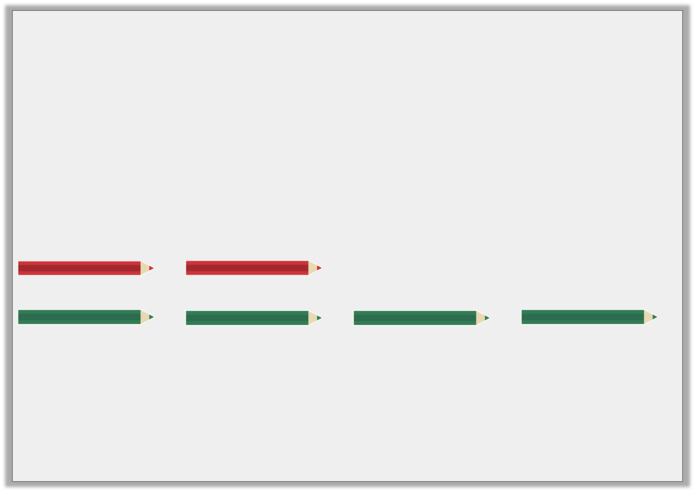
Introduction
David has a packet of pencils.
For every 2 red pencils, there are 4 green pencils.
If there are 30 pencils in total, how many of each colour are there?
© Classroom Secrets Limited 2019

Slide 5
Introduction
David has a packet of pencils.
For every 2 red pencils, there are 4 green pencils.
If there are 30 pencils in total, how many of each colour are there?
Red = 10 pencils Green = 20 pencils
© Classroom Secrets Limited 2019

Slide 6
Varied Fluency 1
Enlarge this shape by a scale factor of 3.
7.4cm
12.2cm
Not to scale
© Classroom Secrets Limited 2019

Slide 7
Varied Fluency 1
Enlarge this shape by a scale factor of 3.
Height: 22.2cm Length: 36.6cm
7.4cm
12.2cm
Not to scale
© Classroom Secrets Limited 2019

Slide 8
Varied Fluency 2
Tommy says,
Is he correct?
A scale factor of two means you multiply each side of the original shape by four.
© Classroom Secrets Limited 2019

Slide 9
Varied Fluency 2
Tommy says,
Is he correct?
No, a scale factor of two means you multiply each side by two.
A scale factor of two means you multiply each side of the original shape by four.
© Classroom Secrets Limited 2019

Slide 10
Varied Fluency 3
Copy this shape onto squared paper.
Draw it using a scale factor of 1.5.
© Classroom Secrets Limited 2019

Slide 11
Varied Fluency 3
Copy this shape onto squared paper.
Draw it using a scale factor of 1.5.
© Classroom Secrets Limited 2019

Slide 12
Varied Fluency 4
True or false?
Shape A has been increased by a scale factor of 2.
B
A
© Classroom Secrets Limited 2019

Slide 13
Varied Fluency 4
True or false?
Shape A has been increased by a scale factor of 2.
False. It has been increased by a scale factor of 1.5.
B
A
© Classroom Secrets Limited 2019

Slide 14
Problem Solving 1
This shape has been enlarged by a scale factor of 3. Find the perimeter of the original shape.
6.6cm
7.2cm
Not to scale
© Classroom Secrets Limited 2019

Slide 15
Problem Solving 1
This shape has been enlarged by a scale factor of 3. Find the perimeter of the original shape.
9.2cm
6.6cm
7.2cm
Not to scale
© Classroom Secrets Limited 2019

Slide 16
Reasoning 1
Caitlin says,
Is she correct?
If I increase the shape by a scale factor of 2.5, the new perimeter will be 56cm.
6.4cm
4.8cm
Not to scale
© Classroom Secrets Limited 2019

Slide 17
Reasoning 1
Caitlin says,
Is she correct?
Yes because…
If I increase the shape by a scale factor of 2.5, the new perimeter will be 56cm.
6.4cm
4.8cm
Not to scale
© Classroom Secrets Limited 2019

Slide 18
Reasoning 1
Caitlin says,
Is she correct?
Yes because the perimeter of the original shape is 22.4cm.
22.4 x 2.5 = 56
If I increase the shape by a scale factor of 2.5, the new perimeter will be 56cm.
6.4cm
4.8cm
Not to scale
© Classroom Secrets Limited 2019

Slide 19
Problem Solving 2
This triangle was enlarged by a scale factor of three.
What were the measurements of the original triangle?
15.3cm
B. 7.2cm
C. 18.9cm
Not to scale
© Classroom Secrets Limited 2019

Slide 20
Problem Solving 2
This triangle was enlarged by a scale factor of three.
What were the measurements of the original triangle?
5.1cm
B. 2.4cm
C. 6.3cm
Not to scale
© Classroom Secrets Limited 2019

